Slide 1

PIZZA SALES ANALYSIS
www.slidesgo.es
BY USING SQL
Presented by Vishwa Babariya

Slide 2
OVERVIEW
About the Project
Data
Detailed Analysis
Key Takeaways
Conclusion

Slide 3


ABOUT THE PROJECT
This project examines pizza sales data from 2015, utilizing SQL to extract valuable insights. The objective is to evaluate sales performance, identifying order preferences and highlight key factors influencing overall business outcomes.
The analysis covers various aspects, including the number of orders, revenue generation, and other essential metrics to assess sales. By exploring these elements, the project aims to provide a deeper understanding of sales dynamics and pizza performance throughout the year, offering insights that can support data-driven decision-making and strategic improvements.

Slide 4

DATA
01
02
03
04
In this analysis, we have used four tables, and the columns within each table are outlined below:
PIZZAS
PIZZA TYPES
pizza_id, pizza_type_id, size, price
pizza_type_id, name, category, ingredients
PIZZA ORDERS
PIZZA ORDER DETAILS
order_id, date, time
order_details_id, order_id, pizza_id, quantity

Slide 5

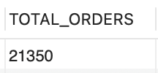

QUERY THE TOTAL NUMBER OF ORDERS PLACED?
Input
Output

Slide 6
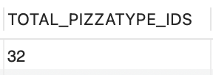
QUERY THE TOTAL NUMBER OF PIZZA TYPES?
Input
Output

Slide 7
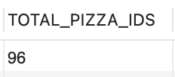
QUERY THE TOTAL NUMBER OF PIZZA ID TYPES?
Input
Output

Slide 8
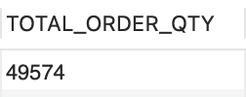
QUERY TOTAL ORDER QUANTITY PLACED?
Input
Output

Slide 9
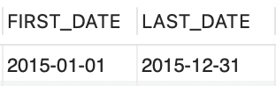
QUERY THE FIRST DATE OF TRANSACTION AND THE LAST DATE OF TRANSACTION?
Input
Output

Slide 10
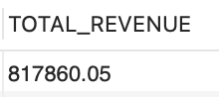
QUERY THE TOTAL REVENUE GENERATED?
Input
Output

Slide 11
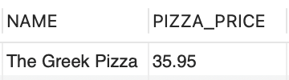
QUERY THE HIGHEST PRICED PIZZA?
Input
Output

Slide 12
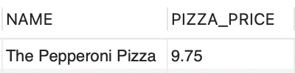
QUERY THE LOWEST PRICED PIZZA?
Input
Output

Slide 13
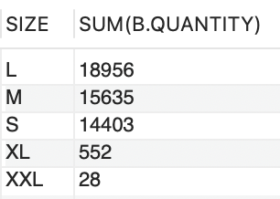
QUERY THE PIZZA ORDERED QTY BY SIZE?
Input
Output

Slide 14
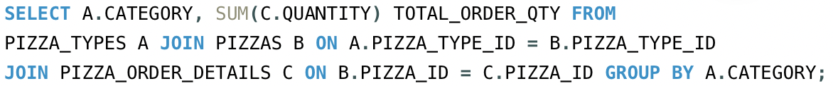
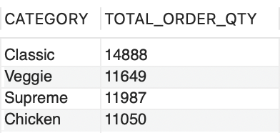
QUERY THE PIZZA ORDERED QTY BY CATEGORY?
Input
Output

Slide 15
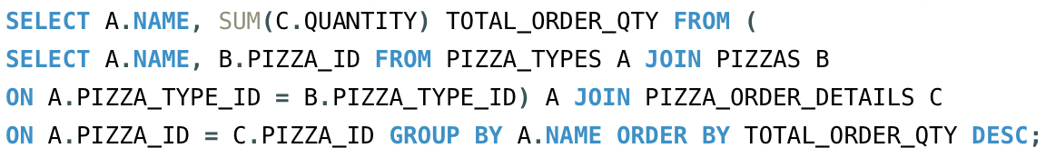
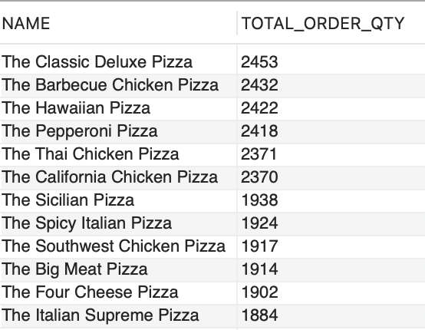
QUERY THE PIZZA ORDERED QTY BY PIZZA NAME?
Input
Output

Slide 16
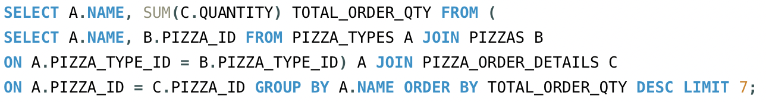
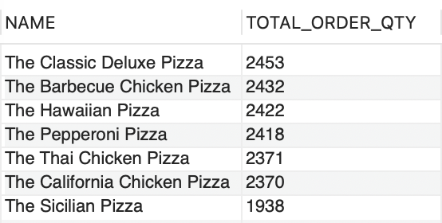
QUERY THE TOP 7 PIZZAS BASED ON THE ORDERS QTY?
Input
Output

Slide 17
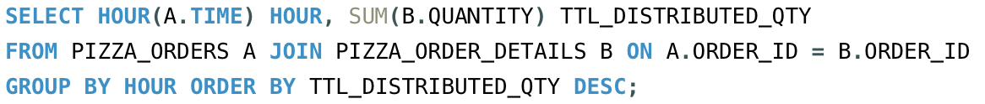
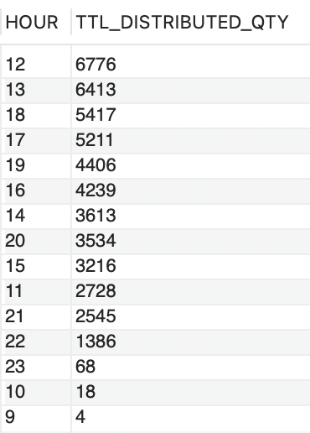
QUERY THE DISTRIBUTION(QUANTITY) OF ORDERS BY HOUR OF DAY?
Input
Output

Slide 18
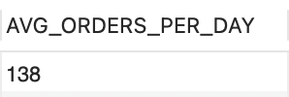
QUERY THE PIZZA ORDER QTY BY DATE AND CALCULATE THE AVERAGE NUMBERS OF PIZZAS ORDERED PER DAY?
Input
Output

Slide 19
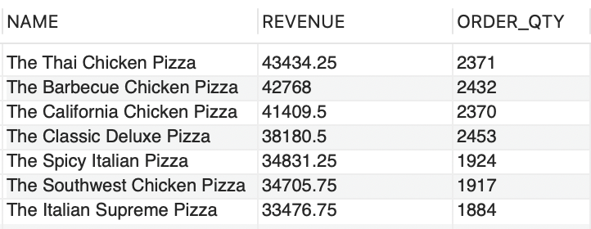
QUERY THE TOP 7 PIZZA BY REVENUE?
Input
Output

Slide 20
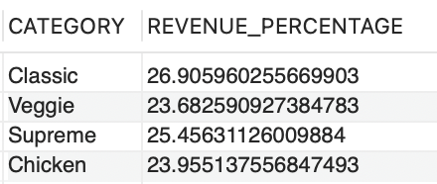
QUERY THE PERECENTAGE CONTRIBUTION OF EACH PIZZA CATEGORY TO TOTAL REVENUE?
Input
Output

Slide 21
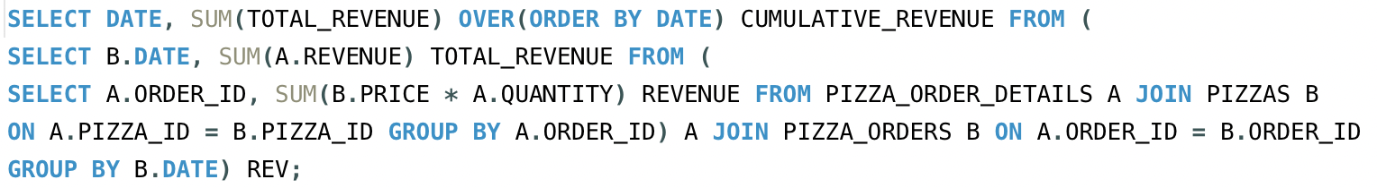
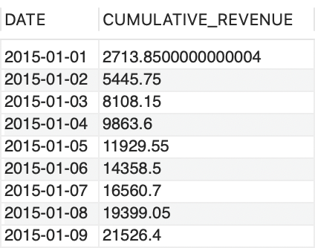
ANALYSE THE QUMULATIVE REVENUE GENERATED OVER DATE?
Input
Output

Slide 22
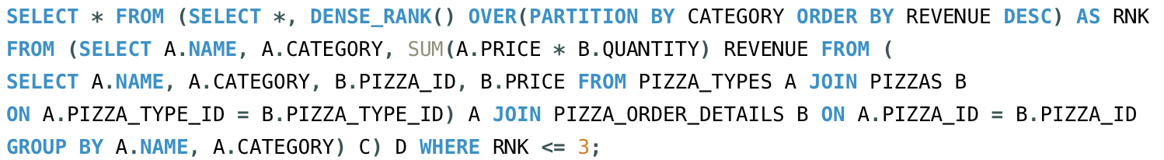
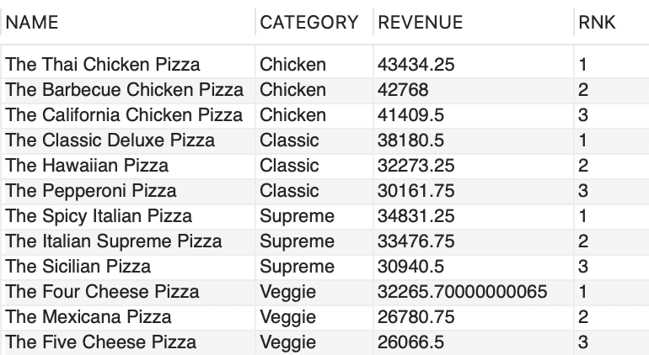
DETERMINE THE TOP 3 MOST ORDERED PIZZAS NAMES BASED ON REVENUE FOR EACH CATEGORY?
Input
Output

Slide 23

KEY TAKEAWAYS
In 2015, large (L) pizzas were the most ordered with an order quantity of 18,956, while XXL pizzas had the lowest demand of 28.
Daily average pizza order quantity is 138.
Classic pizza category were the most popular and had the highest order quantity at 14,888.
The Classic Deluxe Pizza was the top-selling pizza with with an order quantity of 2,453.
Top 7 pizzas by order quantity:
The Classic Deluxe Pizza
The Barbecue Chicken Pizza
The Hawaiian Pizza
The Pepperoni Pizza
The Thai Chicken Pizza
The California Chicken Pizza
The Sicilian Pizza
Classic pizza category contributed 26.91% of the total revenue.
Thai Chicken Pizza generated the highest revenue: $43,434.25.
Most orders were placed during the afternoon peak hours of 12:00–13:00 and the evening peak hours of 17:00–19:00.

Slide 24
THANK
YOU

